Slide 1
Pipelining: Basic Concepts

Slide 2
Topics
What is pipelining?
How is the pipelining Implemented?
What makes pipelining
hard to implement?
What is pipelining?
How is the pipelining Implemented?
What makes pipelining hard to implement?

Slide 3
What is Pipelining ?
Pipelining:
“A technique designed into some computers to increase speed by starting the execution of one instruction before completing the previous one.”
----Modern English-Chinese Dictionary
implementation technique whereby different instructions are overlapped in execution at the same time.
implementation technique to make fast CPUs

Slide 4

It likes Auto Assembly line
An arrangement of workers, machines, and equipment in which the product being assembled passes consecutively from operation to operation until completed.
Ford installs first moving assembly line in 1913. The right picture shows the moving assembly line at Ford Motor Company's michigan plant.
( 84 distinct steps)

Slide 5
Why Pipelining: Its Natural
Laundry
Ann, Brian, Cathy, Dave each have one load of clothes to wash, dry, and fold
Washer takes 30 minutes
Dryer takes 40 minutes
“Folder” takes 20 minutes
A
B
C
D

Slide 6
Sequential Laundry
6 PM
7
8
9
10
11
Midnight
Time
30
40
20
30
40
20
30
40
20
30
40
20
T
a
s
k
O
r
d
e
r
A
B
C
D
Sequential laundry takes 6 hours for 4 loads
If they learned pipelining, how long would laundry take?

Slide 7
Pipelined Laundry--Start work ASAP
6 PM
7
8
9
10
11
Midnight
Time
30
40
40
40
40
20
T
a
s
k
O
r
d
e
r
A
B
C
D
Pipelined laundry takes 3.5 hours for 4 loads

Slide 8
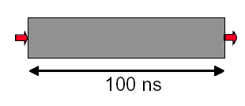
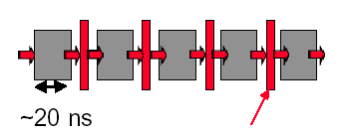
Why pipelining : overlapped
Only deal one task each time.
This task takes
“ such a long time”
Latches, called pipeline registers’ break up computation into 5 stages
Deal 5 tasks at the same time.

Slide 9
Why pipelining: more faster
Can “launch” a new computation every 100ns in this structure
Can finish 10⁷ computations per second
Can launch a new computation every 20ns in pipelined structure
Can finish 5×10⁷ computations per second

Slide 10
Why pipelining : conclusion
The key implementation technique used to Make fast CPU: decrease CPUtime.
Improving of Throughput ( rather than individual execution time)
Improving of efficiency for resources (functional unit)

Slide 11
What is a pipeline ?
A pipeline is like an auto assemble line
A pipeline has many stages
Each stage carries out a different part of instruction or operation
The stages, which cooperates at a synchronized clock, are connected to form a pipe
An instruction or operation enters through one end and progresses through the stages and exit through the other end
Pipelining is an implementation technique that exploits parallelism among the instructions in a sequential instruction stream

Slide 12
Pipeline Characteristics --latency vs. Throughput
Latency
Each instruction takes a certain time to complete. This is the latency for that operation.
It's the amount of time between when the instruction is issued and when it completes.
Throughput
Number of items (cars, instructions) exiting the pipeline per unit time.
The throughput of the assembly line is the number of products completed per hour.
The throughput of a CPU pipeline is the number of instructions completed per second.

Slide 13
Pipeline Characteristics-clock cycle vs. Machine cycle
Clock cycle
Everything in a CPU moves in lockstep, synchronized by the clock ( The Heartbeat of CPU )
Machine cycle (Processor cycle, Stage time)
time required to complete a single pipeline stage.
The pipeline designer’s goal is to balance the length of each pipeline stage.
In many instances, machine cycle = max ( times for all stages).
A machine cycle is usually one, sometimes two, clock cycles long, but rarely more.

Slide 14
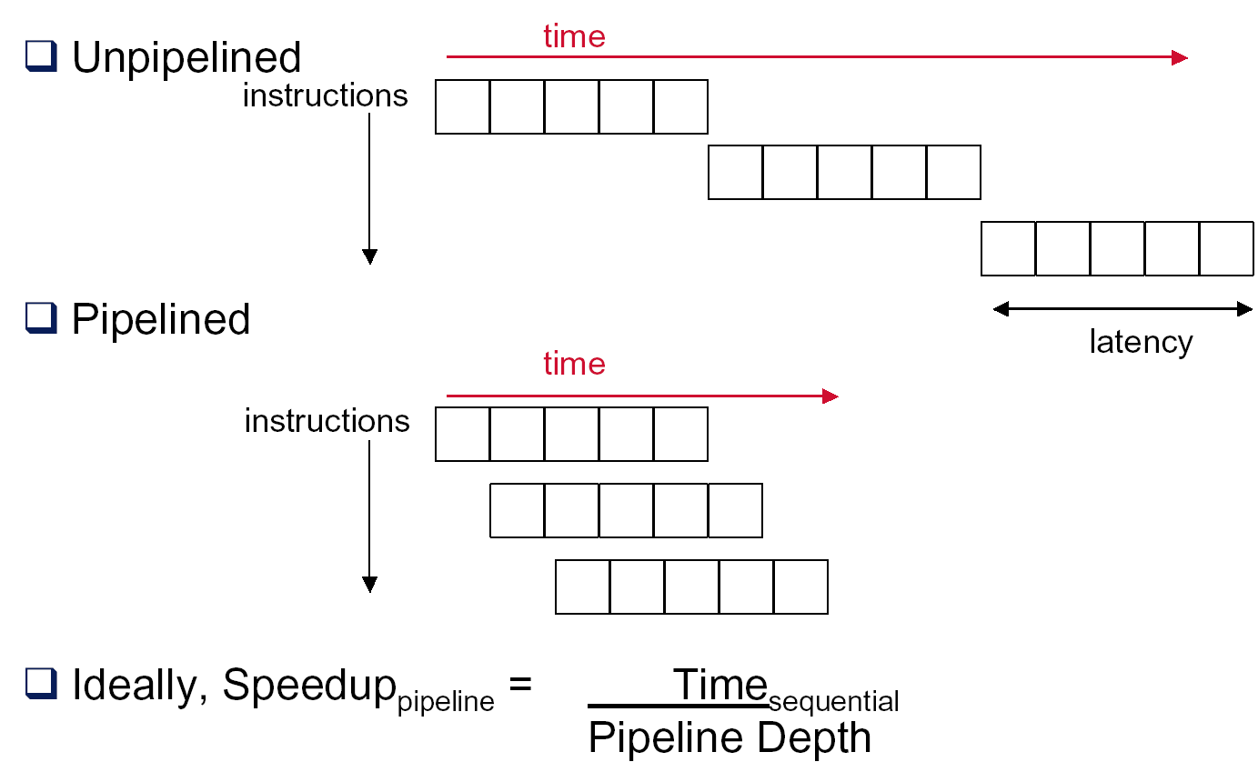
Performance for Pipelining

Slide 15
Ideal Performance for Pipelining
If the stages are perfectly balanced, The time per instruction on the pipelined processor equal to:
Time per instruction on unpipelined machine
Number of pipe stages
So, Ideal speedup equal to
Number of pipe stages.

Slide 16
Simple implementation of a RISC (MIPS)
Start with Implementation without pipelining
single-cycle implementation
multi-cycle implementation
Pipelining the RISC Instruction Set
Pipelining performance issues
How can we do it efficiently ?
Examples

Slide 17
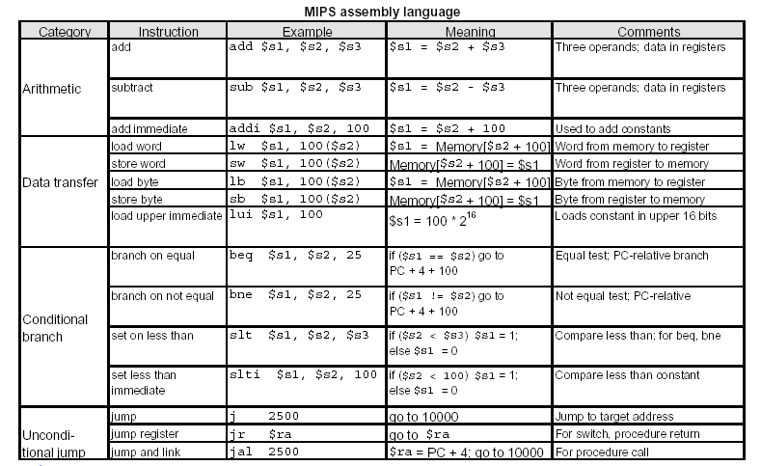
MIPS ISA

Slide 18
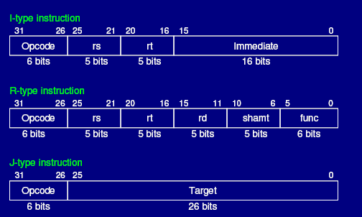
MIPS instruction format

Slide 19
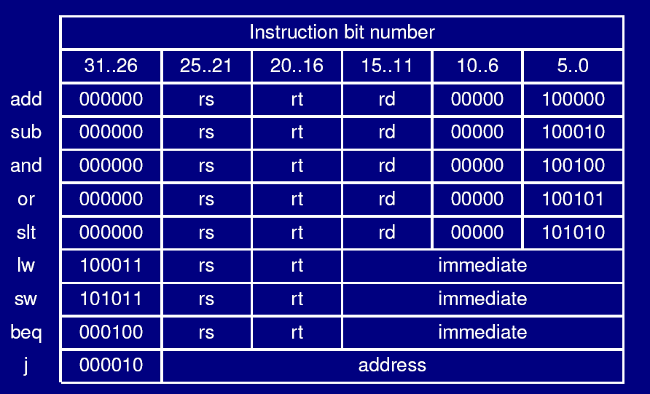
9 Instructions

Slide 20
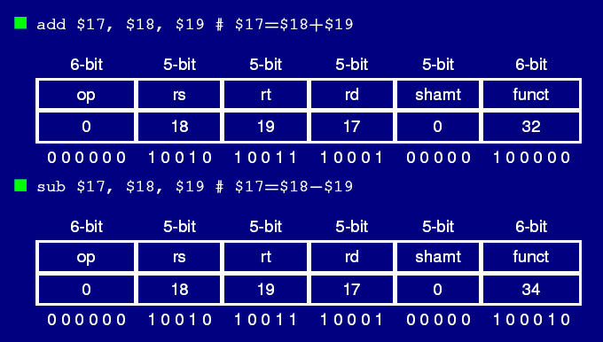
R-instr. Add / Sub

Slide 21
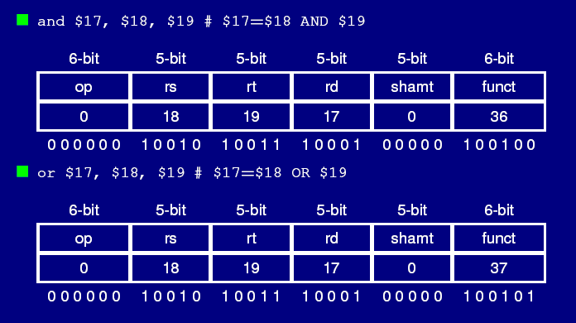
R-Instruction: And/Or

Slide 22
I-Instruction: LW/SW

Slide 23
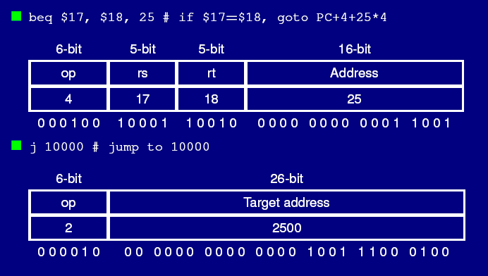
Branch / Jump

Slide 24
SLT: set when less than

Slide 25
Single-cycle implementation
Data Path for R-instruction

Slide 26
R-instruction Data Path

Slide 27
What’s the data path for I-instruction (R-I, LW/SW/BEQ)?

Slide 28
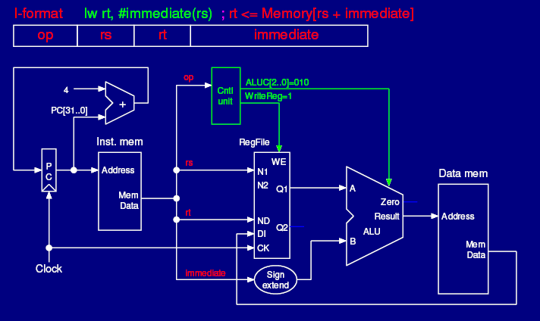
Data Path for LW

Slide 29
Data Path for SW

Slide 30
Data Path for BEQ

Slide 31
What’s the data path for J-instruction (jump)?

Slide 32
Data Path for Jump

Slide 34
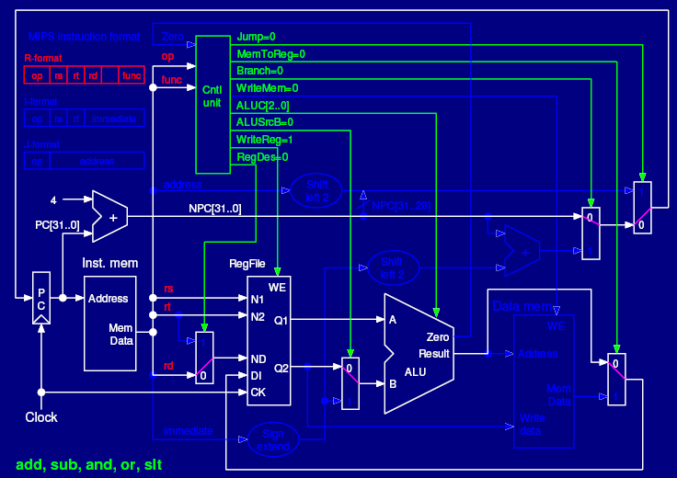

Slide 36
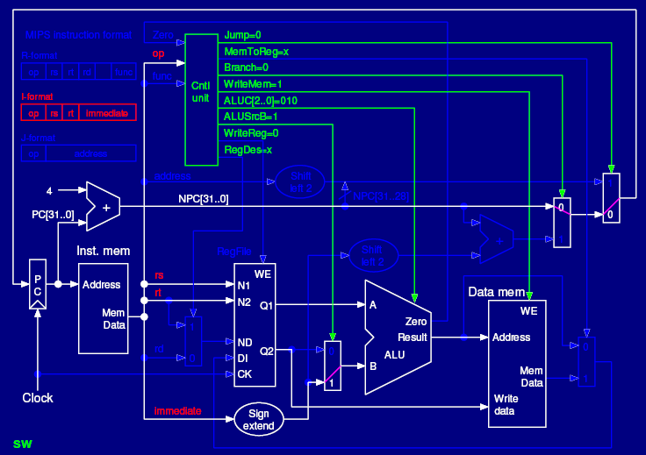

Slide 37
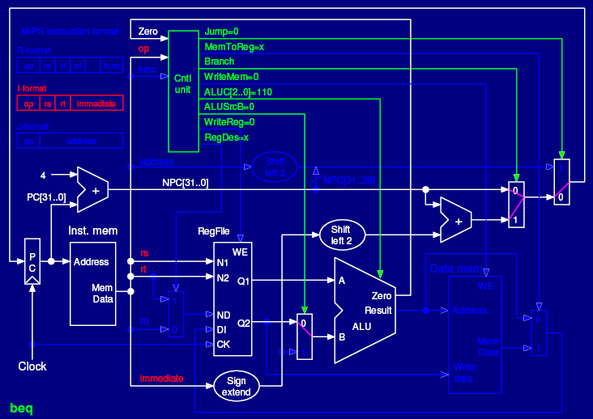

Slide 39
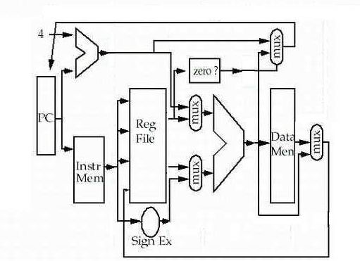
Single-cycle implementation
seldom used !

Slide 40
Single cycle → Multiple cycle

Slide 41
Finite State Diagram

Slide 42
Multiple Cycle MIPS CPU

Slide 43
Multiple Cycle MIPS CPU

Slide 45
5-cycle MIPS CPU

Slide 47
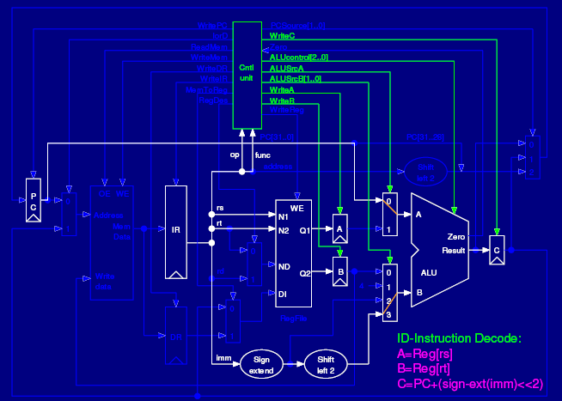

Slide 52
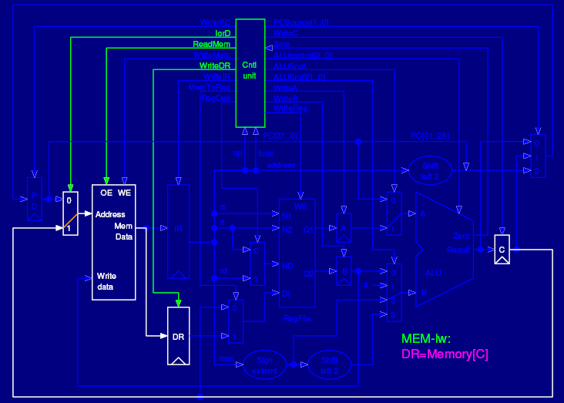

Slide 54
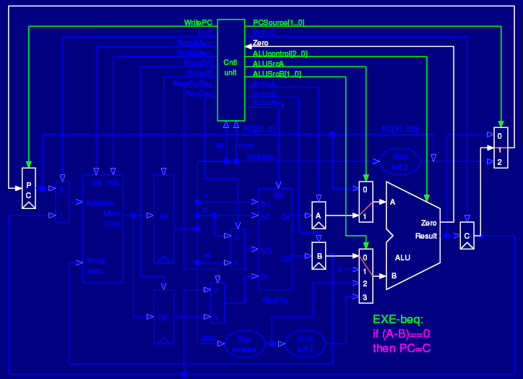

Slide 59
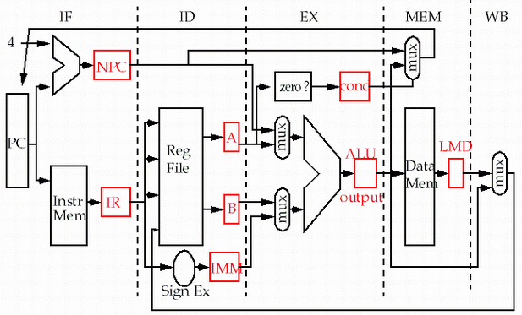
Multi-cycle implementation

Slide 60
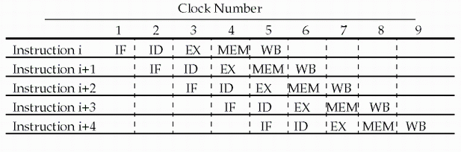
Pipelining MIPS instruction set
Since there are five separate stages, we can have a pipeline in which one instruction is in each stage.
CPI is decreased to 1, since one instruction will be issued (or finished) each cycle.
During any cycle, one instruction is present in each stage.
Ideally, performance is increased five fold !

Slide 61
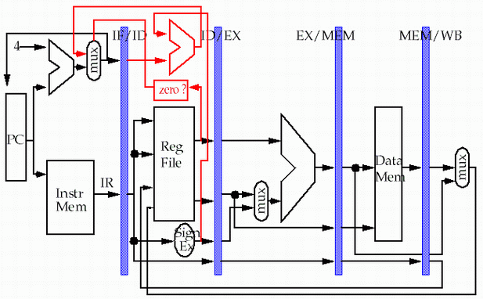
5-stage Version of MIPS Datapath
Why Latches ?
store
pipeline
registers or
latches
load

Slide 62
What should be latched ?
Is register PC a latch ？
What are stored in latch IF/ID ?
IR, anythingelse ?
What are stored in latch ID/EX ?
A, B, imm, anythingelse ?
What are stored in latch EX/MEM ?
ALUoutput, anythingelse ?
What are stored in latch MEM/WB ?
LMDR, ALUoutput, Wreg, anythingelse ?

Slide 63
Single-cycle implementation vs. pipelining
Single Cycle Implementation: CPI=1, long clock cycle
Cycle 1
Cycle 2
Clk
Load
Store
Waste
Pipeline Implementation: CPI=1, clock cycle ≈ long clock cycle/5
Cycle 1
Cycle 2
Cycle 3
Cycle 4
Cycle 5
Cycle 6
Cycle 7
Cycle 8
Cycle 9
Cycle 10
Clk
Load
IF
ID
EX
MEM
WB
Store
IF
ID
EX
MEM
WB
R-type
IF
ID
EX
MEM
WB

Slide 64
Multi-cycle implementation vs. pipelining
Multip-Cycle Implementation: CPI=5,
Cycle 1
Cycle 2
Cycle 3
Cycle 4
Cycle 5
Cycle 6
Cycle 7
Cycle 8
Cycle 9
Cycle 10
Clk
Load
Store
R-type
IF
ID
EX
MEM
WB
IF
ID
EX
MEM
WB
Pipeline Implementation: CPI=1,
Cycle 1
Cycle 2
Cycle 3
Cycle 4
Cycle 5
Cycle 6
Cycle 7
Cycle 8
Cycle 9
Cycle 10
Clk
Load
IF
ID
EX
MEM
WB
Store
IF
ID
EX
MEM
WB
R-type
IF
ID
EX
MEM
WB

Slide 65
How pipelining decrease execution time?
If your starting point is
a single clock cycle per instruction machine then
pipelining decreases cycle time.
a multiple clock cycle per instruction machine then
pipelining decreases CPI.

Slide 66
Instruction pipeline
Cycle 1
Cycle 2
Cycle 3
Cycle 4
Cycle 5
Cycle 6
Cycle 7
Cycle 8
Cycle 9
Cycle 10
Clk
I1
IF
ID
EX
MEM
WB
I2
IF
ID
EX
MEM
WB
I3
IF
ID
EX
MEM
WB
I4
IF
ID
EX
MEM
WB
I5
IF
ID
EX
MEM
WB

Slide 67
Ideal Performance for Pipelining
If the stages are perfectly balanced, The time per instruction on the pipelined processor equal to:
Time per instruction on unpipelined machine
Number of pipe stages
So, Ideal speedup equal to
Number of pipe stages.

Slide 68
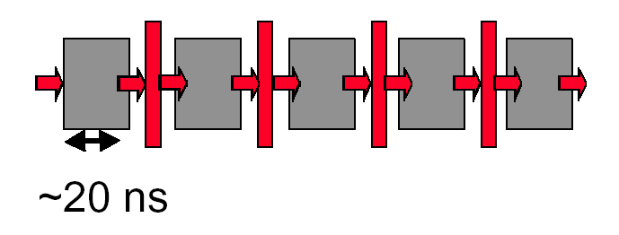
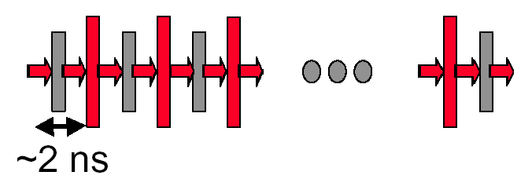
Why not just make a 50-stage pipeline?
Some computations just won’t divide into any finer (shorter in time) logical implementation.
5 stages OK
50 stages NO. Sorry!

Slide 69
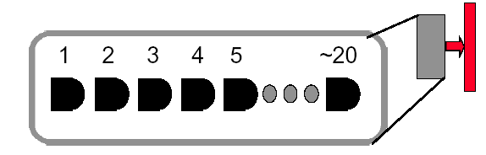
Why not just make a 50-stage pipeline ?
Those latches are NOT free, they take up area, and there is a real delay to go THRU the latch itself.
Machine cycle > latch latency + clock skew
In modern, deep pipeline (10-20 stages), this is a real effect
Typically see logic “depths” in one pipe stage of 10-20 “gates”.
At these speeds, and with this few levels of logic, latch delay is important

Slide 70
performance issues in pipelining
Latency: The execution time of each instruction in pipelining does not decrease, instead, always longer than that of unpipelined machine.
Imbalance among stages reduces performance
Overhead rise from register delay and clock skew also contribute to the lower limit of machine cycle.
Pipeline hazards are the major hurdle of pipeline, which prevent the machine from reaching the ideal performance.
Time to “fill” pipeline and time to “drain” it reduces speedup

Slide 71
How simple as this ! Really ?
pipeline
registers or
latches
Why need to add this line?

Slide 72
Must latches be engaged ? Yeah !
Ensure the instructions in different stages do not interfere with one another .
Through the latches, can the stages be combined one by one to form a pipeline.
The latches are the pipeline registers , which are much more than those in multi-cycle version
IR: IF/ID.IR; ID/EX.IR; EX/DM.IR; DM/WB.IR
B: ID/EX.B; EX/DM.B
ALUoutput: EX/DM.ALUoutput, DM/WB.ALUoutput
Any value needed on a later stage must be placed in a register and copied from one register to the next, until it is no longer needed.

Slide 73
Important Notes:
What should be buffered in every stage latch ?
Data need to be used in the next stages.
Control signals need to be used in the next stages
Debug info when used in duration of design
The memory bandwidth changes !
1 instruction read + 1 data access / 5 cycle (multi-cycle implementation)
1 instruction read + 1 data access / cycle

Slide 74
Problems that pipelining introduces
Focus: no different operations with the same data path resource on the same clock cycle. (structure hazard)
There is conflict about the memory !
Time (clock cycles)
I
n
s
t
r.
O
r
d
e
r
Ld/St
Mem
Reg
ALU
Mem
Reg
Instr 1
Mem
Reg
ALU
Mem
Reg
Instr 2
Mem
Reg
ALU
Mem
Reg
Instr 3
Mem
Reg
ALU
Mem
Reg

Slide 75
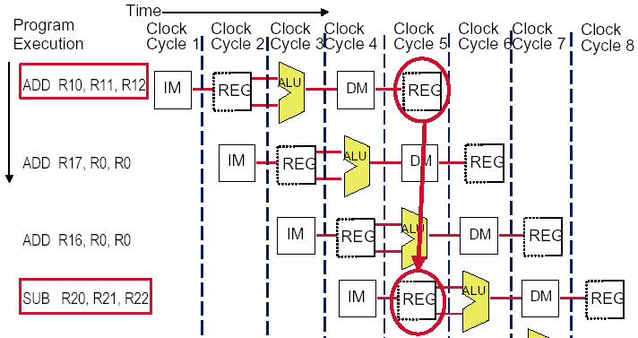
The conflict about the registers !
R10

Slide 76
Conflict occurs when PC update
Must increment and store the PC every clock.
What happens when meet a branch ?
Branches change the value of the PC -- but the condition is not evaluated until ID !
If the branch is taken, the instructions fetched behind the branch are invalid !
This is clearly a serious problem ( Control hazard ) that needs to be addressed. We will deal it later.

Slide 77
Separate instruction and data memories
use split instruction and data cache
the memory system must deliver 5 times the bandwidth over the unpipelined version.
Time (clock cycles)
I
n
s
t
r.
O
r
d
e
r
Ld/St
IM
Reg
ALU
DM
Reg
Instr 1
IM
Reg
ALU
DM
Reg
Instr 2
IM
Reg
ALU
DM
Reg
Instr 3
IM
Reg
ALU
DM
Reg

Slide 78
Pipeline hazard: the major hurdle
A hazard is a condition that prevents an instruction in the pipe from executing its next scheduled pipe stage
Taxonomy of hazard
Structural hazards
These are conflicts over hardware resources.
Data hazards
Instruction depends on result of prior computation which is not ready (computed or stored) yet
Control hazards
branch condition and the branch PC are not available in time to fetch an instruction on the next clock

Slide 79
Hazards can always be resolved by Stall
The simplest way to "fix" hazards is to stall the pipeline.
Stall means suspending the pipeline for some instructions by one or more clock cycles.
The stall delays all instructions issued after the instruction that was stalled, while other instructions in the pipeline go on proceeding.
A pipeline stall is also called a pipeline bubble or simply bubble.
No new instructions are fetched during a stall .

Slide 80
Example: stall to resolve hazard
Focus: NO different operations with the same data path resource on the same clock cycle.
Time (clock cycles)
I
n
s
t
r.
O
r
d
e
r
Ld/St
Mem
Reg
ALU
Mem
Reg
Instr 1
Mem
Reg
ALU
Mem
Reg
Instr 2
Mem
Reg
ALU
Mem
Reg
Instr 3
Mem
Reg
ALU
Mem
Reg

Slide 81
Insert stall by compiler
structural hazard
LW Rx, Ry, Rz
Inst…
Inst…
NOP avoid memory structural hazard
Inst…

Slide 82
Insert stall by compiler
Data hazard
ADD Rx, Ry, Rz
NOP
NOP
AND Rl, Rx, Rw
Control hazard
Beq/Bne Rx, Ry, Label
NOP
…
Pipelining Performance is ate up by inserting NOP by compiler

Slide 83
How to stall ? ----interlock
Stall = control hazard || structural hazard || data hazard
Control hazard:
Instruction in EX or MEM is a Branch or JMP
Data hazard:
RD of Instruction in EX == Rs or Rt of instruction in ID
RD of Instruction in MEM == Rs or Rt of instruction in ID

Slide 84
Insert Stall by compilor
Time (clock cycles)
I
n
s
t
r.
O
r
d
e
r
Ld/St
Mem
Reg
ALU
Mem
Reg
Instr 1
Mem
Reg
ALU
Mem
Reg
Instr 2
Mem
Reg
ALU
Mem
Reg
Nop
Bubble
Bubble
Bubble
Bubble
Bubble
Instr 3
Mem
Reg
ALU
Mem
Reg

Slide 85
How do we stall ? Insert nop by compiler
Bubble
Bubble
Bubble
Bubble
Bubble
Bubble
Bubble
Bubble
Bubble

Slide 86
How do we stall? Add hardware Interlock !
Add extra hardware to detect stall situations
Watches the instruction field bits
Looks for “read versus write” conflicts in particular pipe stages
Basically, a bunch of careful “case logic”
Add extra hardware to push bubbles thru pipe
Actually, relatively easy
Can just let the instruction you want to stall GO FORWARD through the pipe…
…but, TURN OFF the bits that allow any results to get written into the machine state
So, the instruction “executes” (it does the work), but doesn’t “save”

Slide 87
How to Stall ? Add a stall control logic !
PC IF/ID ID/EX EX/MEM MEM/WB
M.Inst
D.Inst
E.Inst
F.Inst
Bubble
Bubble
Branch
Branch
Wreg
Wreg
Rd
Rd
Stall control logic
Rs
Rt
stall
To produce a stall signal. If stall ==1 then
Use stall to disable writing PC write and IF/ID latch.
Push a bubble into next stage.
Bubble = 1 and disable control signal Wreg and Wmem.
Puch a nop forward into ID/EX

Slide 88
Control signals
 | Output Signal | Meaning When 1 | Meaning When 0
1 | Cu_branch | Branch Instr. | Non-Branch Instr.
2 | Cu_shift | sa | Register data1
3 | Cu_wmem | Write Mem. | Not Write Mem.
4 | Cu_Mem2Reg | From Mem. To Reg | From ALUOut To Reg
5 | Cu_sext | Sign-extend the imm. | No sign extended the imm.
6 | Cu_aluc | ALU Operation
7 | Cu_aluimm | Imm. | Register data2
8 | Cu_wreg | Write Reg. | Not Write Reg.
9 | Cu_regrt | rt | rd

Slide 89
Something about control signals
How to know the instruction in EXE/MEM is a Branch?
EXE.branch ==1 or Mem.branch == 1
How to know the instruction in EXE/MEM is a ALU or LW instruction ( has a destination reg.) ?
EXE.Wreg ==1 or Mem.Wreg == 1
How to know the instruction in EXE/MEM is a LW ?
EXE.Wreg==1 and Mem2Reg == 1
Which instruction has no rs ?
Jmp, JAL
Which instruction has rt as source register?
ALU r-r, Beq, Bne, SW

Slide 90
How to stall ?
Are the stalls the same for
Data hazard / control hazard ?
If stall == 0 //stop the latter ones
then PC ← new PC; IF/ID.IR ← IF.IR
IF/ID.NPC ← PC + 4
If stall == 1 // push bubble forward
then ID/EX.nop ←1 else ID/EX.nop ←0
When initial
ID/EX.nop ←0, EX/MEM.nop ← 0, Mem.WB.nop ←0

Slide 91
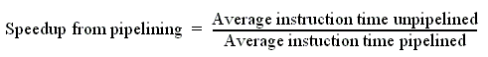
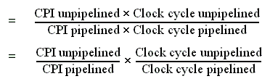
Performance of pipeline with stalls
Pipeline stalls decrease performance from the ideal
Recall the speedup formula:

Slide 92
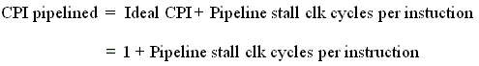
Assumptions for calculation
The ideal CPI on a pipelined processor is almost always 1. (may less than or greater that )
So
Ignore the overhead of pipelining clock cycle.
Pipe stages are ideal balanced.
Two different implementation
single-cycle implementation
multi-cycle implementation

Slide 93
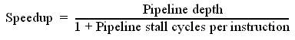
Case of single-cycle implementation
CPI unpipelined = 1
Clock cycle unpipelined
pipeline depth
• Clock cycle pipelined =

Slide 94
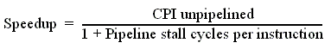
Case of multi-cycle implementation
Clock cycle unpipelined = Clock cycle pipelining
CPl unpipelined = pipeline depth

Slide 95


